Slide 1
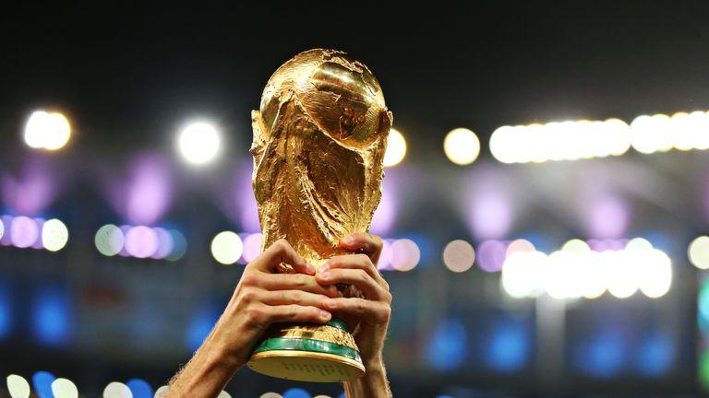
Soccer/ Football Winner Predictor
Juan Lopez
ECE 677

Slide 2
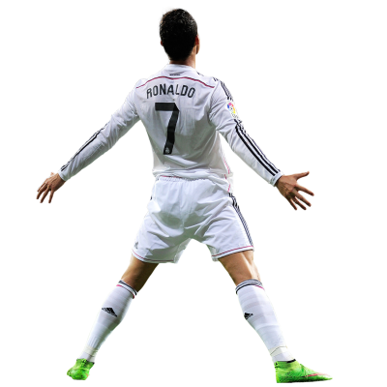
Why?
Soccer has a huge fan base of around 3.5 billion people.
Personal fan of certain leagues means there is high chance of Domain Knowledge
Listening to commentators predict outcomes has now become more autonomous using data mining and machine learning to create predictions
Can be taken step furthers in terms of betting odds FIFA world cup challengers/ winners.
Integration into other sports

Slide 3
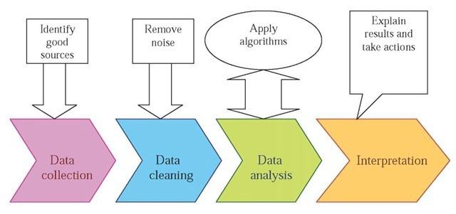
Steps
Scrape CSV file Cleaning/ 3 Different Best Model/ Optimization
Preprocessing Data Models

Slide 4
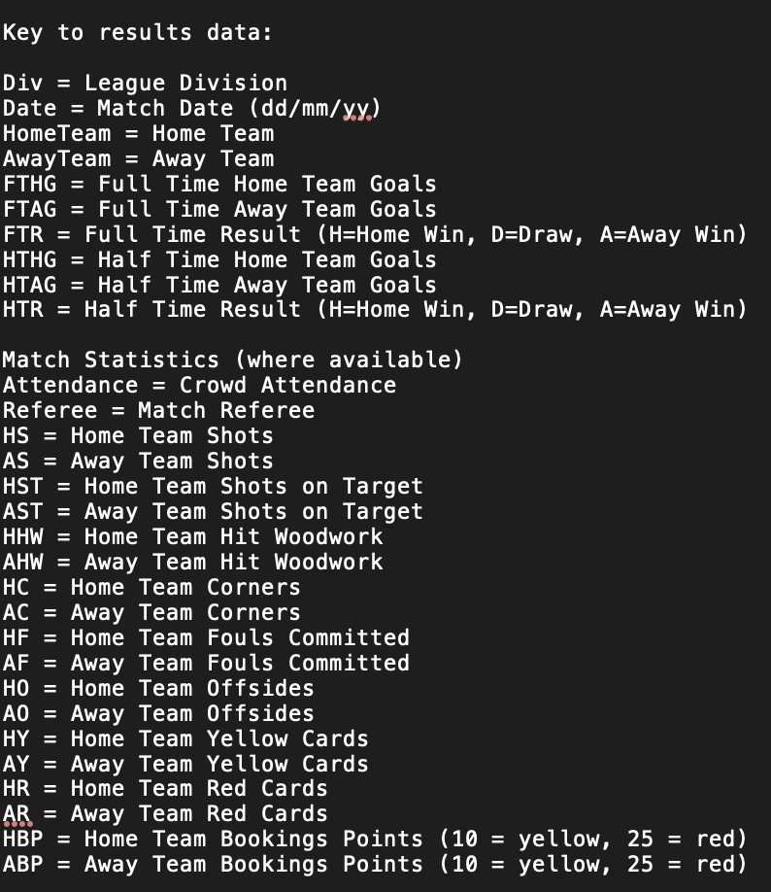
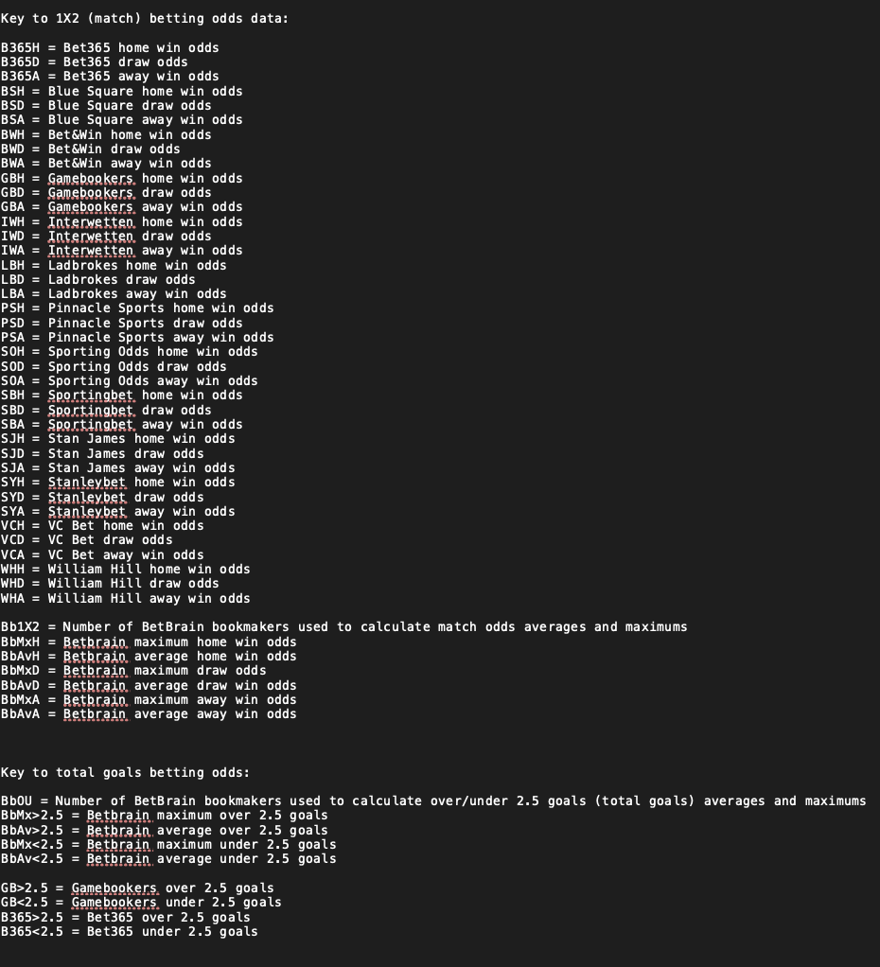
Second Step: Data Cleaning and Preprocessing
The first step before applying the 3 learning models is to preprocess and clean the data.
The data was very large coming from the European Football Results CSV files from the years 1993-2020.
Getting Data on the last 17 years of Premier League soccer got us around about 6000 different match instances and about 63 attributes to choose from.
This is why domain knowledge is important
Removing Features:
Domain Knowledge suggesting things that aren’t important.
Preprocessing:
- One-Hot Encoding for Nominal
- Bounding numeric values with z score scaling
See if any attributes are prioritized for example home games account for higher percentage of winning than away. About 46% of the time

Slide 5
Second Step Continued.
After I preprocess the data I had obtained about 20 attributes I thought were viable into training a model.
Some attributes include
Location they were playing either at home or away
Record for past 3 games
The numerical total of last 3 games L=+0 D=+1 W=+3
The record of goals conceded and goals scored between the last 3 games.
The reason for some of these attributes is because it is important to also note a teams confidence that can’t be directly valued as “being on fire” in the moment which they could be on a winning streak. Or the lack of confidence on a losing streak which would make a team’s desire to win high or low. I created new attributes using one-hot encoding characterized as Win1 Win2 Win3 which would look like like if they won last 3 games as 111 or if they only won their first and last game out of the 3 it would look like 101

Slide 6
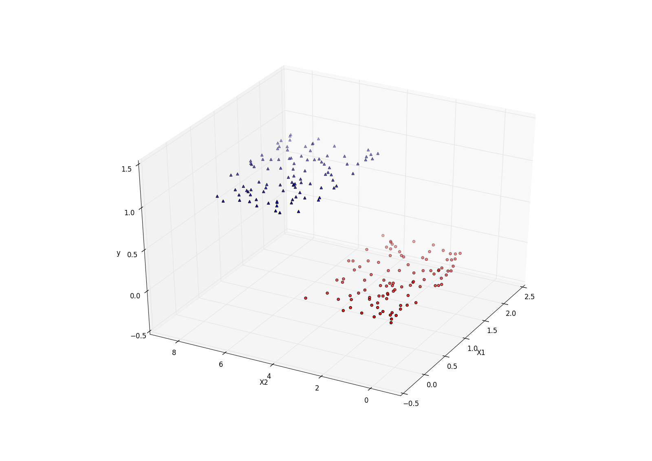
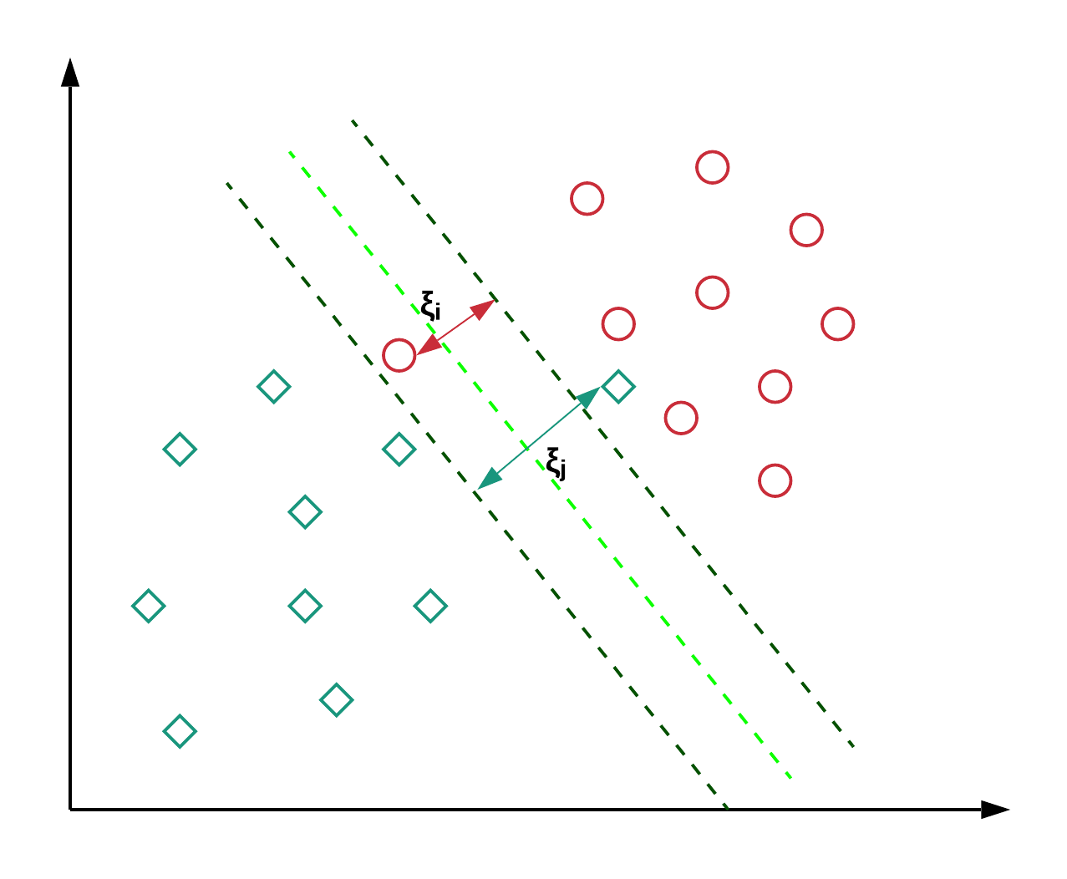
3 Models for Learning
Logistic Regression
This is a regression model in which we could predict the probability that a certain entries belongs to certain classes based on the sigmoid function
XGBoost:
This is a model used in building trees that continuously improves and fixes the previous errors created by the previously trained tree.
Support Vector Machine:
This is done to differentiate between classes that are significantly different and thus creates a certain separation gap that is as wide as possible clearly defining certain classes.

Slide 7
Analysis
-There has been several studies done on these classification learning algorithms in sports. As we can see from the result. We had a better prediction than just stating that 46% of the games at home are won or at random chance of 33% given that we can also account for wins at home, or away or even draws.
-Other studies were done on Football matches that found 54.7% classification accuracy based on different models using Naive Bayes or Neural Networks.
 | Support Vector Machine | XGBoost | Logistic Regression
Accuracy | Testing: 53.39% | Testing: 53.21% | Testing: 53.75%
F1-Score | Testing: 42.15% | Testing: 44.84% | Testing: 43.95%

Slide 8
Some further Optimization
Implementing a grid search into optimizing the parameters of the XGBoost significantly improved our ability to generate better results. This is done because of the GridSearch ability to find the most optimal values for the parameters.
Different data splits also helped the learning models and for XGBoost it did not create the issue of overfitting a training model.
At a 90/10 split between training and testing the results were as follows
F1-Score | Testing: 58.35%
Accuracy | Testing: 56.78%

Slide 9
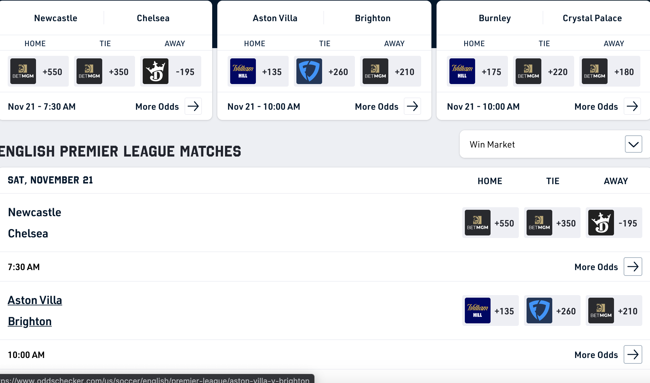
Future Integration
The integration of live “data” in terms of betting odds could be very significant in helping someone bet more on certain teams based on the idea that they will win.
This integration could also include the idea of Implied Probability which can be another attribute added and calculated simultaneously to it’s live broadcast.

Slide 10
Conclusion
Though there were some challenges at first. Instead of just implementing the whole entire CSV file and just instances were values were missing. My Accuracy was way to high at about 99%. Looking at the data seeing that because the model was able to train on the goals scored vs goals conceded of the match it could obviously tell who won automatically. This is why Data processing and Data cleaning was very important. Using the previous games data of goals scored and goals conceded we were able to give a better estimation without knowing how many goals they scored in this game as a parameter. This project really taught me the importance of Data Cleaning and Preprocessing as or even more important than the actual training of the models.

Slide 11
References
http://www.football-data.co.uk/data.php
http://sunsite.tut.fi/rec/riku/soccer.html
http://www.soccerstatistically.com/blog/2013/7/15/goal-time-analysis.html
https://punkrockor.com/2020/07/02/a-soccer-win-probability-model/

